Slide 1
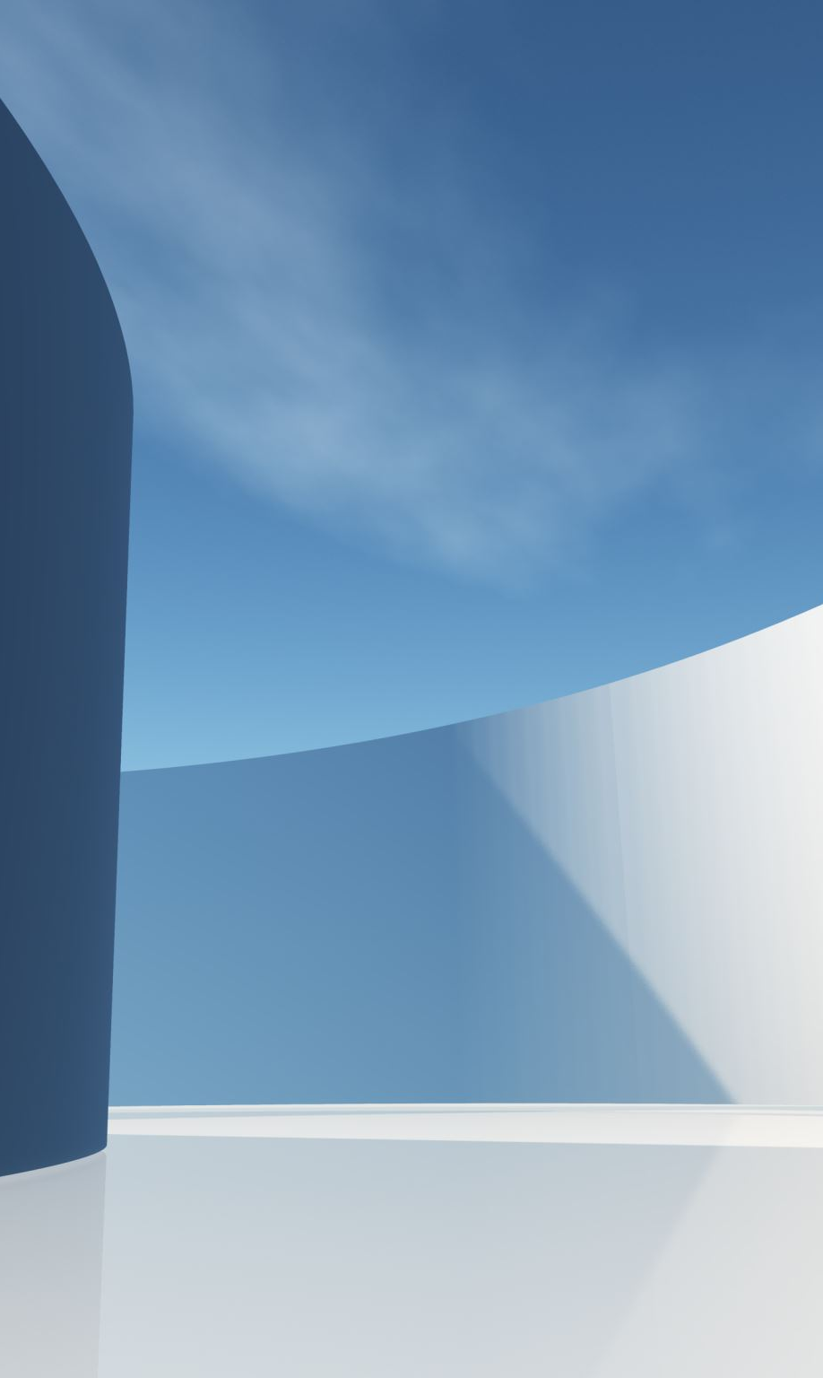
Detecting Racial bias in FACIAL Recognition Software
Machine Learning Final Project
Spring 2024
Bianca gunawan
Elena gualda
Maya Mireles rios
Notes:
Maya

Slide 2
Racial bias in FACIAL Analytic systems
Facial recognition algorithms have higher false positive rates for Asian and African American faces compared to Caucasian faces (The National Institute of Standards and Technology, 2019)
Facial recognition systems from major tech companies exhibited higher error rates for darker-skinned women (up to 34.7%) compared to lighter-skinned men (0.8%) (Buolamwini and Gebru, 2018)
Existing public face image datasets predominantly feature Caucasian faces, leading to underrepresentation of other races
Efforts to diversify train data have been made to help mitigate bias
Notes:
Maya

Slide 3
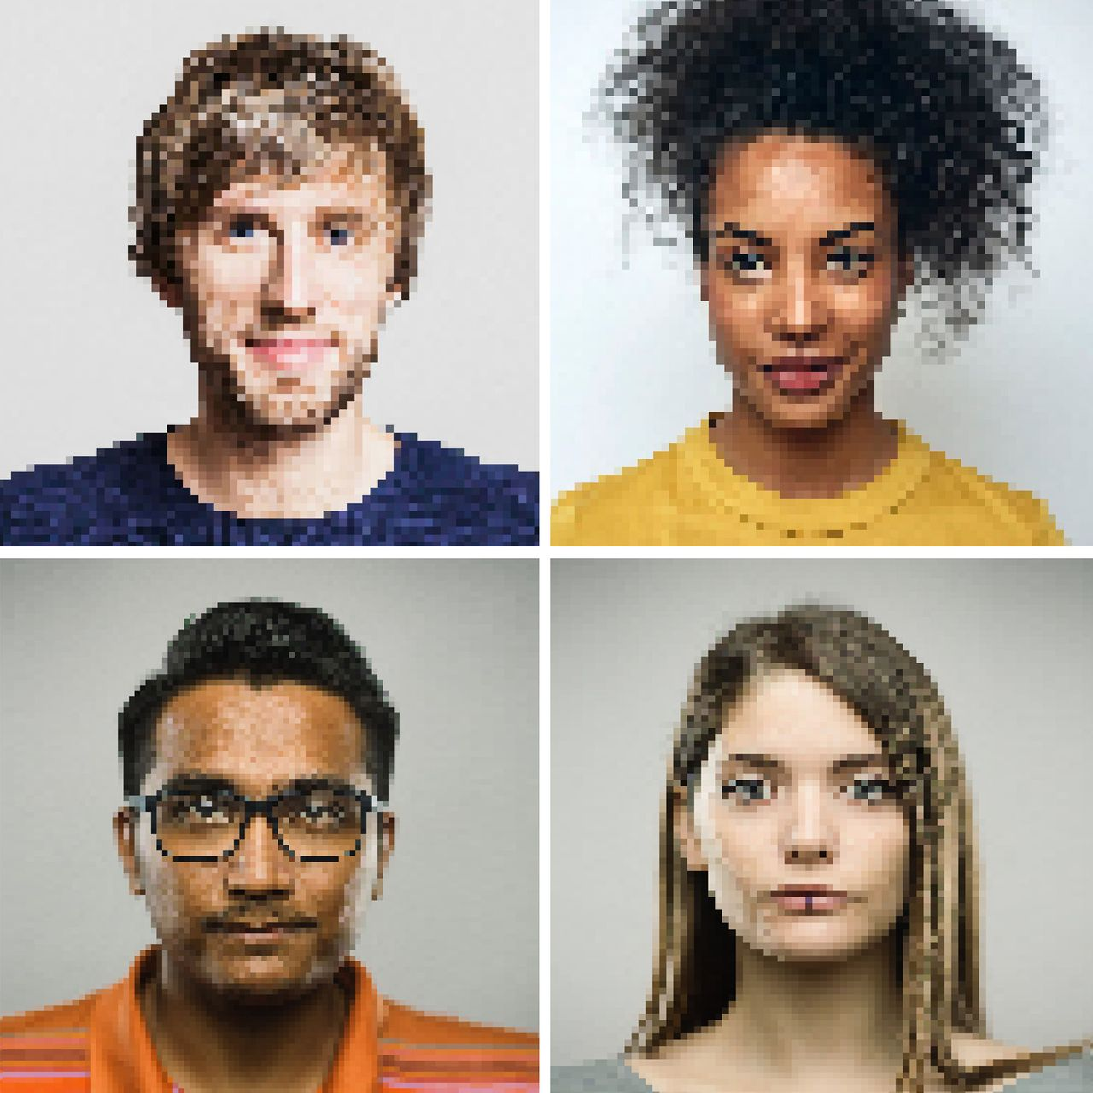
Our approach
The Problem
Where does racial bias exist in deep learning software?
What role does the dataset play in the performance of these models?
Goals of Analysis
Explore the impact of more diverse data sets on model performance
Compare the performance of different models given same data
Notes:
Maya

Slide 4
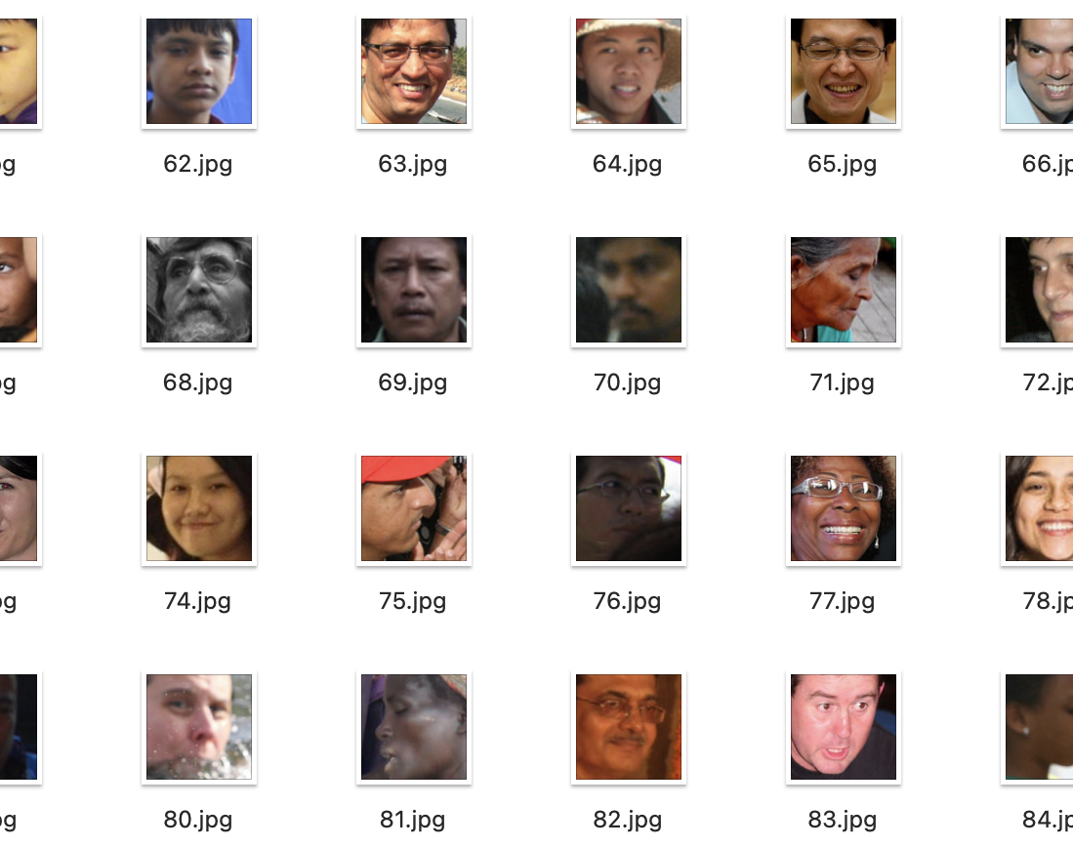
Data Set & Description
Data set was sourced from GitHub.
Racially diverse data set called FairFace
86,744 Facial JPEG Images labeled
7 races
Age range 0-70+
Gender: Female & Male
Due to computational power and efficiency, we took 3000 facial images for our Deep Learning analysis
Resized Images to 224 x 224
Notes:
Bianca

Slide 5
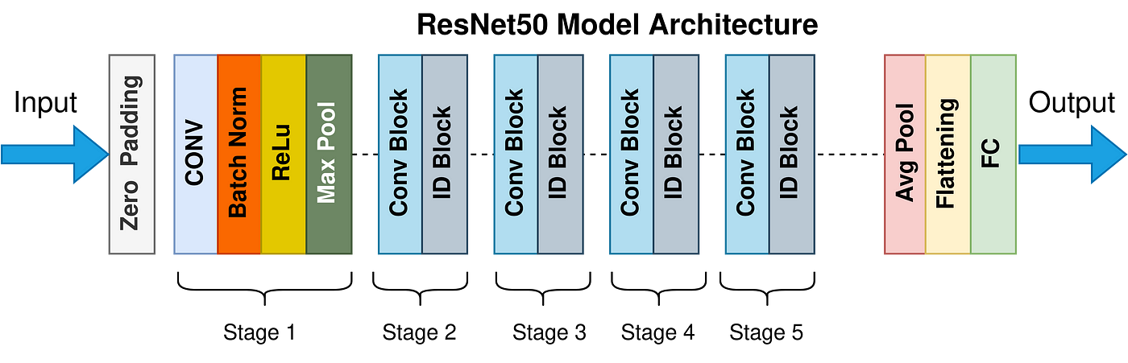
Resnet-50 SUMMARY
50-layer convolutional neural network​
Forms networks by stacking residual blocks, allow for the direct flow of information through the skip connections, mitigating the vanishing gradient problem
Fewer filters and is less complex than a VGGNet
Deep Residual Learning for Image Recognition
Notes:
Bianca - It can classify images into 1,000 object categories, such as keyboard, mouse, and pencil
Rectified linear unit (ReLU) or rectifier activation function introduces the property of nonlinearity to a deep learning model and solves the vanishing gradients issue.

Slide 6
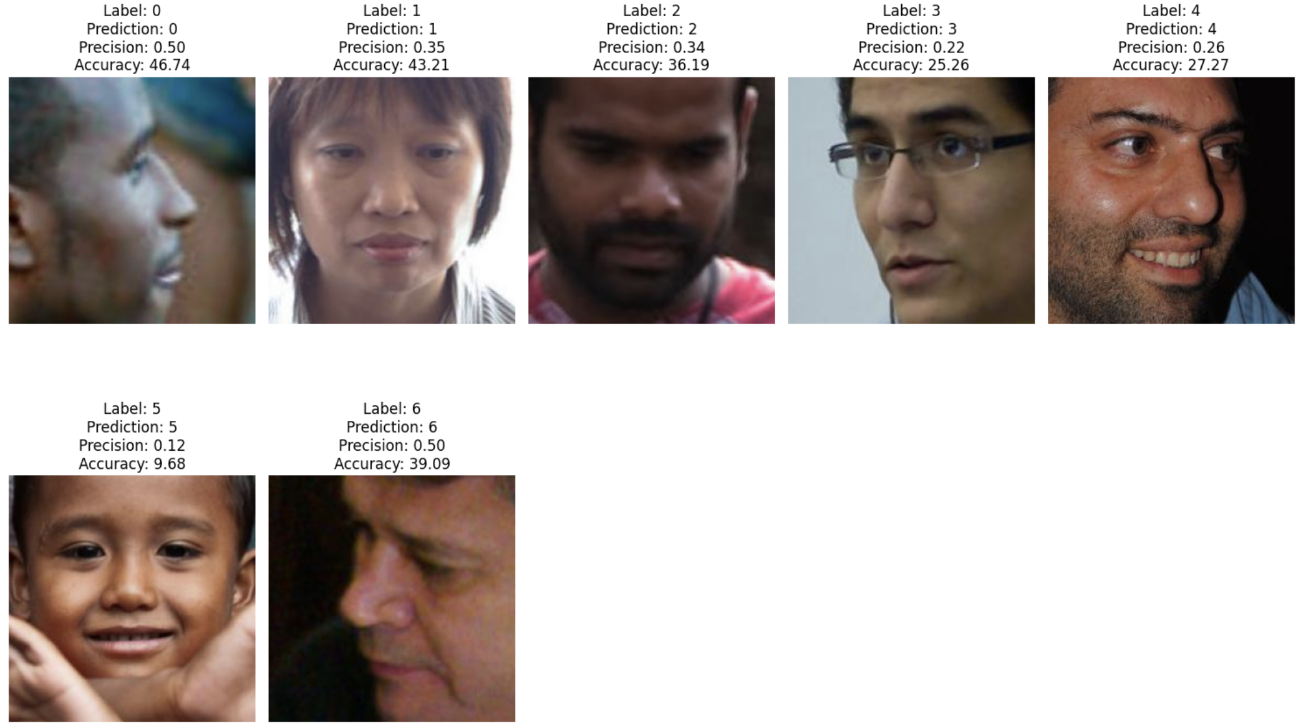

RESNET-50 Results
3,000 images into 80/20 Train-Test Split
Overall Test Accuracy: 34.0%
Significantly low accuracy and precision for Southeast Asian, but quite balanced for other races.
Notes:
Bianca

Slide 7
Inception resnetv1– pretrained with VGG Model - Explained
Inception: Multiple convolutional filters to process the image which captures different features for image.
Each filter is a different size (e.g., 1x1 for fine details, 3x3 for medium patterns & max pooling, 5x5 for large patterns)
All the outputs from filters are concatenated which combines features to a single tensor(multi-dim array).
ResNetV1: Creates shortcuts so model can jump layers to gather info from earlier layers and pass it on.
Gradients flow backward easily during backpropagation which allows the neural network to be much deeper.
Pretrained – VGGFace2: Dataset from Oxford with 3.3 million images. Deep CNN Layers are used in VGG model architecture.
InceptionResNetV1 is trained on the VGGFace2 dataset and is a prime example of transfer learning.
Notes:
Elena

Slide 8
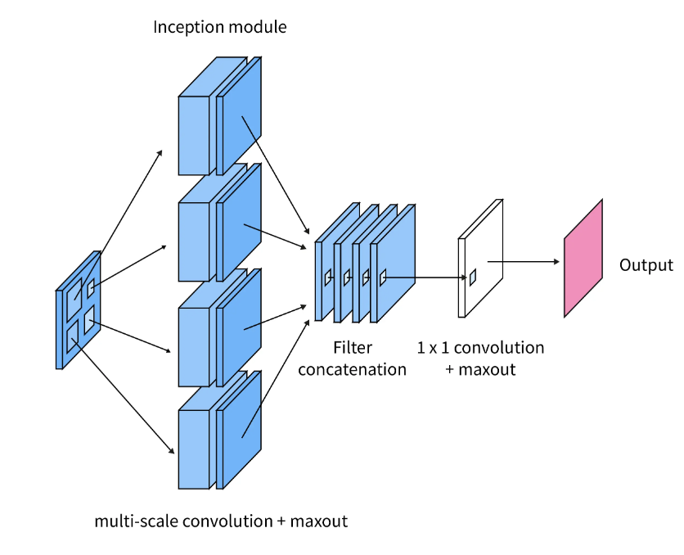
Inception resnetv1– pretrained with VGG Model - Summary
Summary: Each model feature has its own contribution to the neural network architecture for understanding images:
Inception: Feature Extraction
ResNetV1 (Residual): Training of Deep Networks
Pretrained VGG: Weighs the model in transfer learning
Notes:
Elena

Slide 9
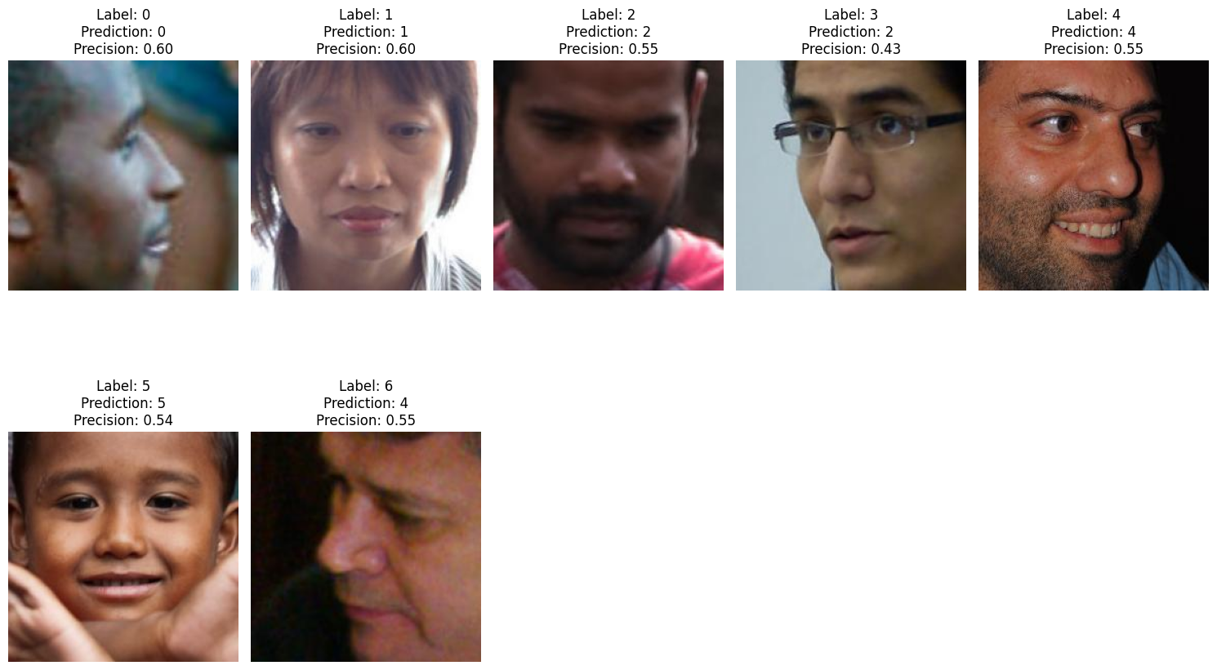
Inception resnetv1– pretrained with VGG Model – Methodology & Results
3,000 images into 80/20 Train-Test Split
Overall Test Accuracy: 52.50%
Accuracy for:
Label 0 (Black): 73.91%
Label 1 (East Asian): 62.96%
Label 2 (Indian): 45.71%
Label 3 (Hispanic): 31.58%
Label 4 (Middle Eastern): 25.45%
Label 5 (SE Asian): 50.00%
Label 6 (White): 66.36%
Notes:
Elena

Slide 10
Inception resnetv1– pretrained on casia-webface
Same Hybrid Architecture: Combines Inception modules and Residual Connections to leverage both depth and width
Casia-Webface: large-scale face dataset that contains over 10,000 subjects and 494,414 images, making it one of the most popular datasets for training face recognition systems
Notes:
Maya

Slide 11
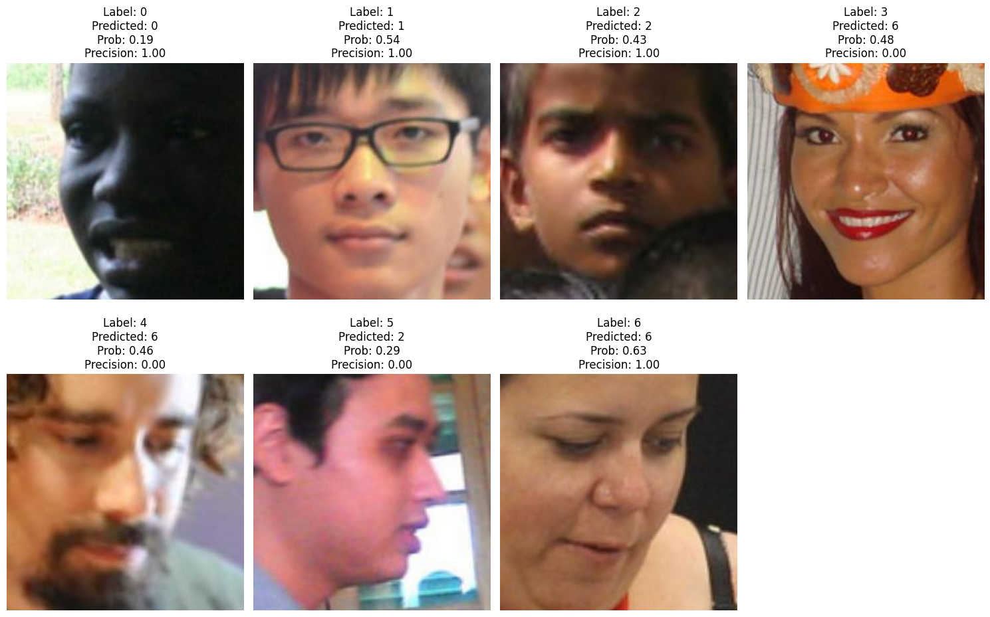
Inception resnetv1(pretrained with casia-webface) Results
3,000 images into 80/20 Train-Test Split
Overall Test Accuracy: 40.50%
Accuracy for:
Label 0 (Black): 64.13%
Label 1 (East Asian): 48.15%
Label 2 (Indian): 29.52%
Label 3 (Hispanic): 29.47%
Label 4 (Middle Eastern): 0%
Label 5 (SE Asian): 27.42%
Label 6 (White): 62.73%
Notes:
Maya

Slide 12
Conclusion
RESNET50 is trained on object images, resulting low and varying facial recognition accuracy for different race class. This also suggests presence of racial bias
INCEPTION RESNETV1(PRETRAINED WITH VGG2) is very robust and continually improves its accuracy the higher sample size its trained with. It demonstrates varying levels of accuracy based on race, suggesting that racial bias exists.
INCEPTION RESNETV1(PRETRAINED WITH CASIA-WEBFACE) demonstrates varying levels of accuracy based on race, suggesting that racial bias exists
Notes:
Elena

Slide 13
Future directions
Accuracy improves the more data its fed. We could not increase train size due to RAM & GPU as of now
Fine-tune the pre-trained models with manually added layers
Explore other models that are more specific to facial recognition, such as FaceNet and DeepID
Notes:
Elena

Slide 14
Thank you!

Slide 15
Resources
Data
https://github.com/joojs/fairface
References
https://proceedings.mlr.press/v81/buolamwini18a/buolamwini18a.pdf
https://www.scaler.com/topics/inception-network/

